Slide 1
“E –COMMERCE INSIGHTS FROM FLIPKART DATA USING PYTHON AND EDA”
Turning Data into Insights
Raghavendra Addagatla
Batch No : 427 b

Slide 2
About me
I am Raghavendra Addagatla, a Bachelor of Technology (B. Tech) graduate In Electronics and Communication Engineering.
I chose Data Analyst as it’s a fast-growing field that powers innovation across every industry.
It allows me to build skills in Python, analytics, and visualization for real-world applications.
LINKDIN :
🔗 https://www.linkedin.com/in/raghavendra-addagatla-31a526389/
GIT HUB :
🔗 https://github.com/raghavendra0780-debug

Slide 3
INTRODUTION
This project focuses on extracting and analyzing data from Flipkart’s e-commerce platform to gain valuable insights into Realme 5G smartphones.
Using Python and web scraping techniques, product details such as names, prices, RAM, ROM, and ratings were collected and structured into a clean dataset.
After data collection, Exploratory Data Analysis (EDA) was performed to understand trends, relationships, and patterns among product features.
The analysis includes both univariate and bivariate techniques to explore how attributes like price, RAM, ROM, and rating influence one another.
The primary objective of this project is to transform raw web data into meaningful insights that can help customers make informed decisions and assist businesses in identifying product trends and competitive pricing strategies.

Slide 4
PROBLEM STATEMENT
In today’s online marketplace, customers are often overwhelmed by a wide variety of smartphone options with varying prices, features, and specifications.
There is no direct, structured way to compare and analyze product data like RAM, ROM, ratings, and prices from e-commerce platforms such as Flipkart.
Despite the availability of vast product information on e-commerce platforms like Flipkart, the data is unstructured and scattered across multiple web pages.
Thus, there is a need to collect, clean, and analyze this data to uncover insights that help understand market trends, product performance, and customer preferences.
This helps in transforming raw, unorganized web data into valuable insights that can support data-driven decision-making in the e-commerce sector.

Slide 5
OBJECTIVE
To extract real-time smartphone data (specifically Realme 5G models) from Flipkart using Python-based web scraping techniques.
To clean and preprocess the collected data by handling missing or inconsistent values.
To perform Exploratory Data Analysis (EDA) and identify relationships between features such as price, rating, RAM, and ROM.
  Top-rated and top-selling mobile brands
  Price trends and distribution among brands
  Relationship between price and product feature
To visualize the insights using univariate and bivariate analysis for better interpretation.
To help customers and sellers make data-driven decisions based on the analysis results.

Slide 6









TOOLS AND LIBRARIES

Slide 7
DATA COLLECTION (WEB SCRAPING)
STEPS INVOVLED :
1. Initialized Lists
Created empty lists to store details like: Product Name, Price, Rating, Display, Camera, Processor, RAM.
2. Added Request Headers
Used a User-Agent header to mimic a real browser and prevent blocking by Flipkart.
3. Scraped Multiple Pages (1–20)
Used a for loop to go through 20 pages of Flipkart search results.
4. Extracted Product Details
  Parsed the HTML using Beautiful Soup.
  Extracted key features like product name, price, rating, and specifications from each card.
  Appended all extracted values to the corresponding lists.
5. Created a Structured Dataset
  After extraction, combined all lists into a pandas Data Frame.
  Verified lengths and saved data for further cleaning and analysis.

Slide 8
DATA FRAME CREATION
Combined All Lists
Merged the extracted lists — Product Name, Price, Rating, Display, Camera, Processor, RAM, ROM —
into a single DataFrame using pandas.
Verified Column Lengths
Checked that each list had the same number of entries to avoid data mismatch.
Created DataFrame
Constructed a DataFrame with clear column names and arranged data systematically.
Sample Data Validation
Displayed the first few rows (df.head() to confirm proper alignment and accuracy.)
Exported as CSV File
Saved the cleaned data as realme_flipkart_data.csv for further analysis and visualization.

Slide 9
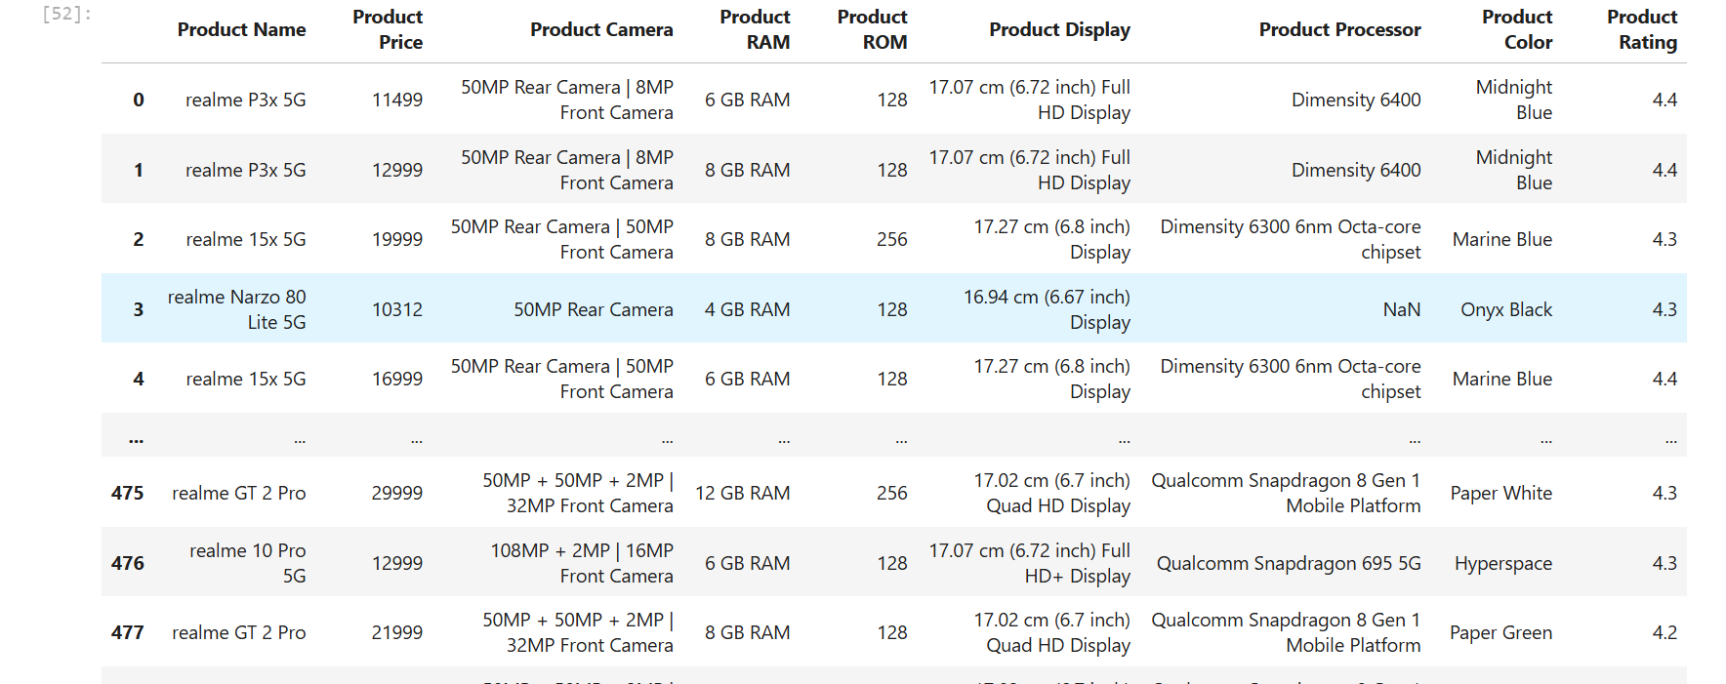
DATA FRAME

Slide 10
EXPLORATORY DATA ANALYSIS(EDA)
1. Univariate Analysis
Examined individual features like:
  Product Price Distribution
  Ratings Distribution
  RAM and ROM capacities
  Top-rated and top-selling models
2. Bivariate Analysis
Studied relationships between two variables:
  Price vs. Rating – to see if higher price leads to better ratings
  RAM vs. Price – to identify performance-price correlation
  ROM vs. Price – for storage impact on pricing

Slide 11
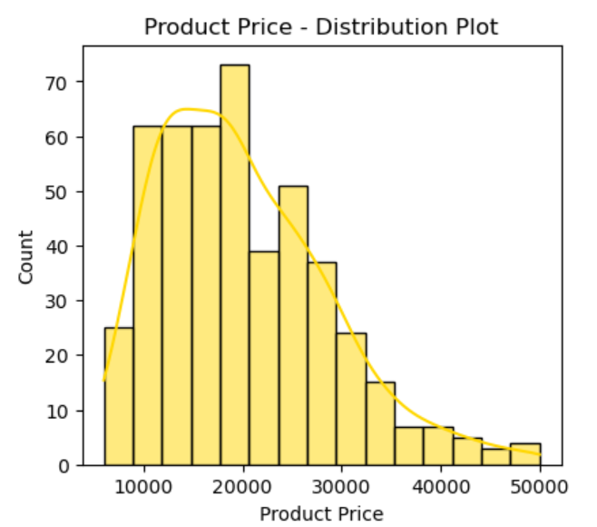
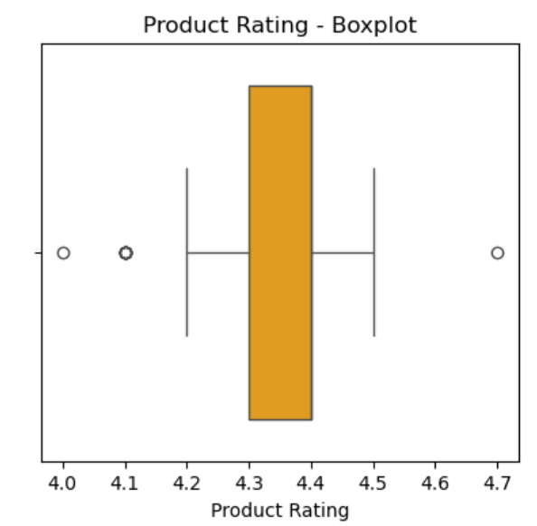
UNIVARIATE ANALYSIS

Slide 12
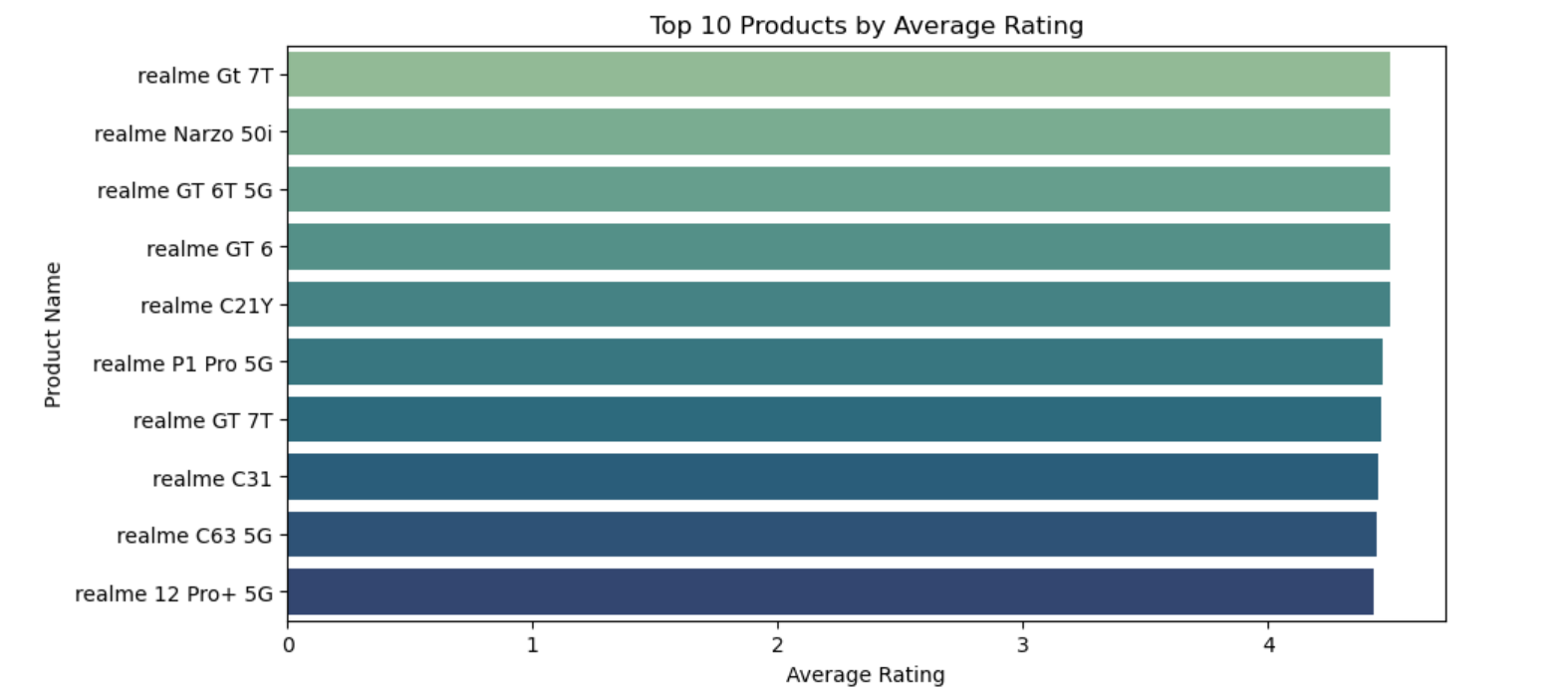
BIVARIATE ANALYSIS

Slide 13
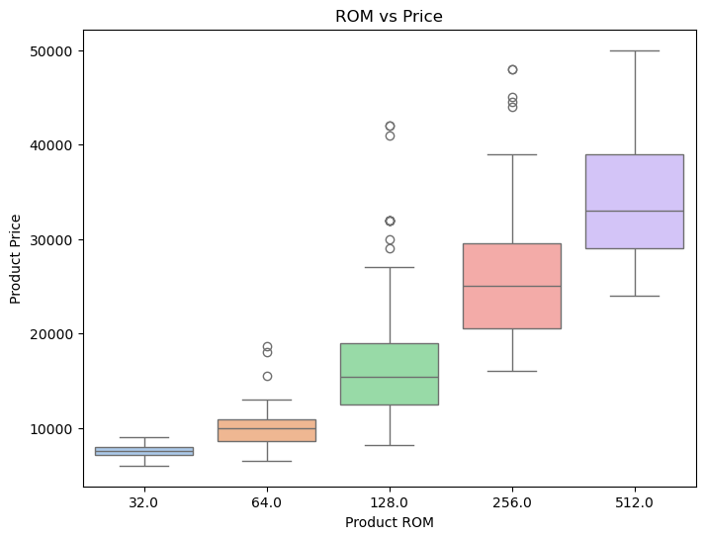
BIVARIATE ANALYSIS

Slide 14
KEY BUSINESS QUESTION
What is the relationship between price and product rating?
Which Realme models are most popular and top-rated?
Do technical specifications (like RAM or processor) significantly affect price?
What are the price trends among Realme 5G smartphones on Flipkart?

Slide 15
CONCLUSION
Key Insights:
Most Realme smartphones fall in the ₹12,000–₹18,000 price range.
Phones with higher RAM and better processors tend to have higher ratings.
Average rating across models is 4.2 – 4.4, showing good overall customer satisfaction.
Price and features show a positive correlation, confirming that better specs lead to higher cost.
Final Conclusion:
Through this project, we identified data-driven trends that help both customers
(for smarter purchase decisions) and brands (for pricing strategies).

Slide 16
EXPERIENCE– WEB SCRAPING
Experience:
Learned the complete data pipeline — from web scraping to visualization.
Gained practical experience with BeautifulSoup, Pandas, and Matplotlib.
Improved understanding of real-world data handling and EDA.
Challenges Faced:
Handling missing and inconsistent data during cleaning.
Dealing with dynamic Flipkart pages while scraping.
Converting raw scraped text into clean, usable numeric formats.
Time taken to visualize and interpret large datasets.

Slide 17
THANK YOU

